Slide 1
Chapter : Testing Tactics

Slide 2
Testing Fundamental
Software engineer attempts to build software from an abstract concept to a tangible product. Next is Testing.
The engineer creates a series of test cases that are intended to "demolish" the software that has been built.
In fact, testing is the one step in the software process that could be viewed as destructive rather than constructive.

Slide 3
Testing Objective
Primary Objective
  Testing is a process of executing a program with the intent of finding an error.
  A good test case is one that has a high probability of finding an as-yet undiscovered error.
  A successful test is one that uncovers an as-yet-undiscovered error
Objective is to design tests that systematically uncover different classes of errors and to do so with a minimum amount of time and effort.
Testing demonstrates that software functions appear to be working according to specification, that behavioral and performance requirements appear to have been met.
Data collected as testing is conducted provide a good indication of software reliability and some indication of software quality as a whole.
But testing cannot show the absence of errors and defects, it can show only that software errors and defects are present.

Slide 4
Testing Principles
All tests should be traceable to customer requirements.
Tests should be planned long before testing begins.
The Pareto principle applies to software testing.
Testing should begin “in the small” and progress toward testing “in the large.”
Exhaustive testing is not possible.
To be most effective, testing should be conducted by an independent third party.

Slide 5
Software Testability
S/w testability is simply how easily system or program or product can be tested.
Testing must exhibit set of characteristics that achieve the goal of finding errors with a minimum of effort.
Characteristics of s/w Testability:
Operability - “The better it works, the more efficiently it can be tested”
  Relatively few bugs will block the execution of tests.
  Allowing testing progress without fits and starts.

Slide 6
Observability - "What you see is what you test.“
  Distinct output is generated for each input.
  System states and variables are visible or queriable during execution.
  Incorrect output is easily identified.
  Internal errors are automatically detected & reported.
  Source code is accessible.
Controllability - "The better we can control the software, the more the testing can be automated and optimized.“
  Software and hardware states and variables can be controlled directly by the test engineer.
  Tests can be conveniently specified, automated, and reproduced.
Decomposability - By controlling the scope of testing, we can more quickly isolate problems and perform smarter retesting.
  Independent modules can be tested independently.

Slide 7
Simplicity - The less there is to test, the more quickly we can test it."
  Functional simplicity (e.g., the feature set is the minimum necessary to meet requirements).
  Structural simplicity (e.g., architecture is modularized to limit the propagation of faults).
  Code simplicity (e.g., a coding standard is adopted for ease of inspection and maintenance).
Stability - "The fewer the changes, the fewer the disruptions to testing."
  Changes to the software are infrequent.
  Changes to the software are controlled.
  Changes to the software do not invalidate existing tests.
Understandability – "The more information we have, the smarter we will test."
  Dependencies between internal, external, and shared components are well understood.
  Changes to the design are communicated to testers.
  Technical documentation is instantly accessible, well organized, specific and detailed, and accurate.

Slide 8
Testing attributes
A good test has a high probability of finding an error.
  Tester must understand the software and attempt to develop a mental picture of how the software might fail.
A good test is not redundant.
  Testing time and resources are limited.
  There is no point in conducting a test that has the same purpose as another test.
  Every test should have a different purpose
  Ex. Valid/ invalid password.
A good test should be “best of breed”
  In a group of tests that have a similar intent, time and resource limitations may mitigate toward the execution of only a subset of these tests.
A good test should be neither too simple nor too complex.
  sometimes possible to combine a series of tests into one test case, the possible side effects associated with this approach may mask errors.
  Each test should be executed separately

Slide 9
TEST CASE DESIGN
Objectives of testing, we must design tests that have the highest likelihood of finding the most errors with a minimum amount of time and effort.
Test case design methods provide a mechanism that can help to ensure the completeness of tests and provide the highest likelihood for uncovering errors in software.
Any product or system can be tested on two ways:
Knowing the specified function that a product has been designed to perform; tests can be conducted that demonstrate each function is fully operational while at the same time searching for errors in each function (Black Box)
knowing the internal workings of a product, tests can be conducted to ensure that "all gears mesh," that is, internal operations are performed according to specifications and all internal components have been effectively exercised. (White box testing)

Slide 10
White box testing
White-box testing of software is predicated on close examination of procedural detail.
Logical paths through the software are tested by providing test cases that exercise specific sets of conditions and/or loops.
The "status of the program" may be examined at various points.
White-box testing, sometimes called glass-box testing, is a test case design method that uses the control structure of the procedural design to derive test cases.

Slide 11
White box testing
Using this method, SE can derive test cases that
Guarantee that all independent paths within a module have been exercised at least once
Exercise all logical decisions on their true and false sides,
Execute all loops at their boundaries and within their operational bounds
Exercise internal data structures to ensure their validity.

Slide 12
White box testing
Testing techniques:
Statement coverage: In this technique, the aim is to traverse all statement at least once. Hence, each line of code is tested. In case of a flowchart, every node must be traversed at least once. Since all lines of code are covered, helps in pointing out faulty code.

Slide 13
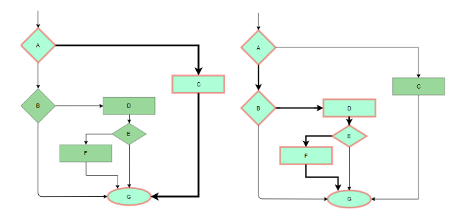
White box testing
Statement coverage

Slide 14
White box testing
Branch Coverage: In this technique, test cases are designed so that each branch from all decision points are traversed at least once. In a flowchart, all edges must be traversed at least once.

Slide 15
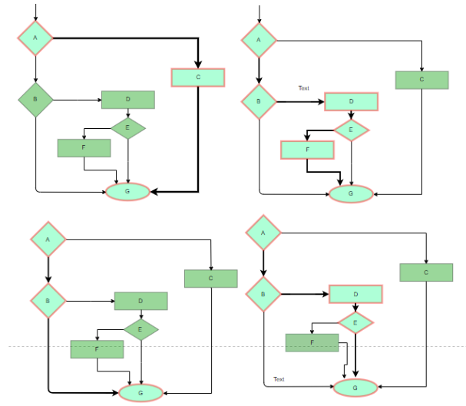
White box testing
Branch coverage

Slide 16
White box testing
Condition Coverage: In this technique, all individual conditions must be covered as shown in the following example:
READ X, Y
IF(X == 0 || Y == 0)
PRINT ‘0’
In this example, there are 2 conditions:
X == 0 and Y == 0. Now, test these conditions get TRUE and FALSE as their values. One possible example would be:
#TC1 – X = 0, Y = 55
#TC2 – X = 5, Y = 0

Slide 17
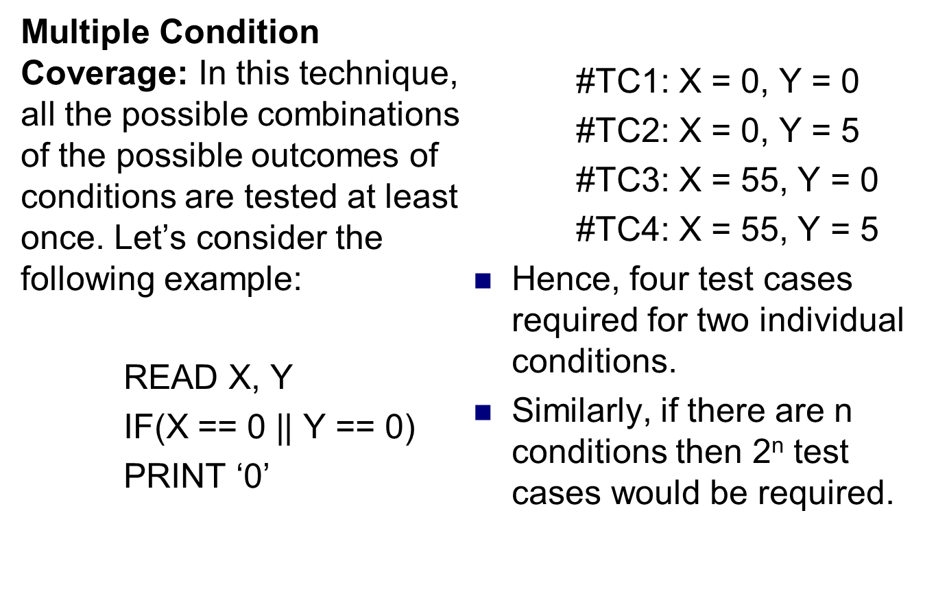
White box testing

Slide 18
Basis path testing
Basis path testing is a white-box testing technique
To derive a logical complexity measure of a procedural design.
Test cases derived to exercise the basis set are guaranteed to execute every statement in the program at least one time.
Methods:
Flow graph notation
Independent program paths or Cyclomatic complexity
Deriving test cases
Graph Matrices

Slide 19
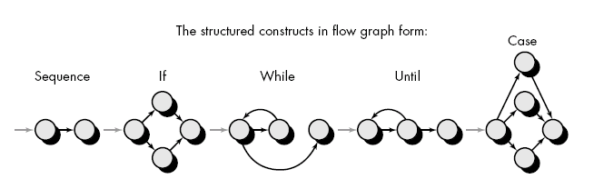
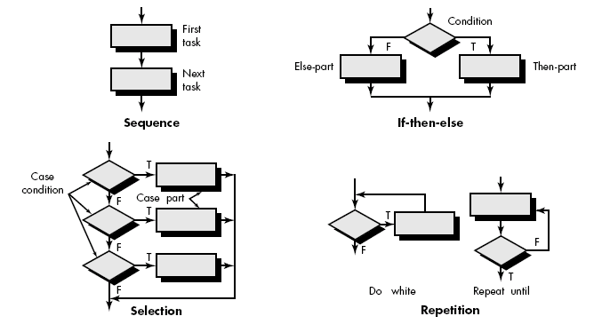
Flow Graph Notation
Start with simple notation for the representation of control flow (called flow graph). It represent logical control flow.

Slide 20
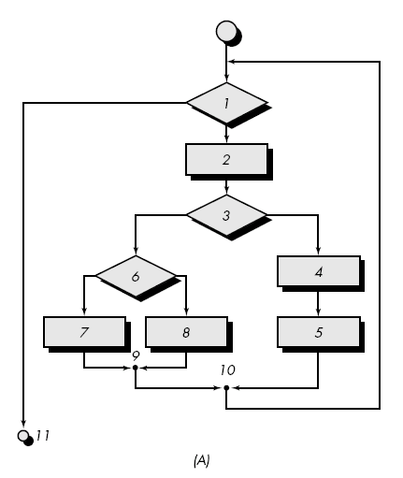
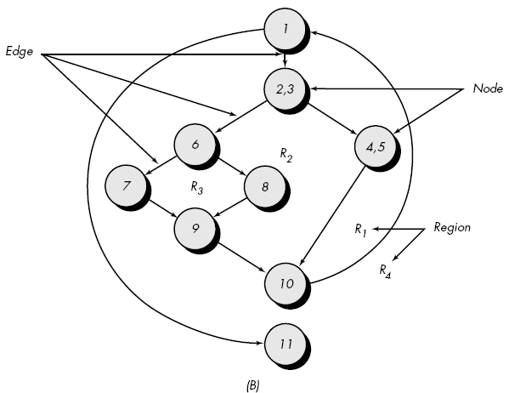
Fig. A represent program control structure and fig. B maps the flowchart into a corresponding flow graph.
In fig. B each circle, called flow graph node, represent one or more procedural statement.

Slide 21
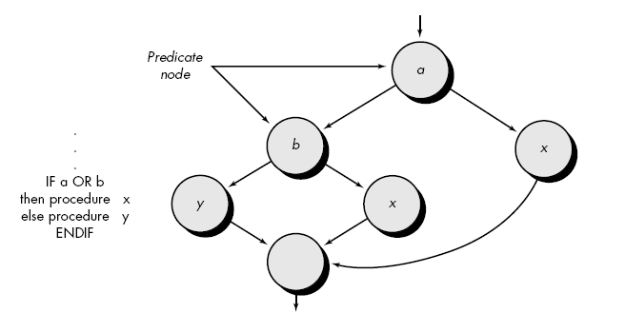
A sequence of process boxes and decision diamond can map into a single node.
The arrows on the flow graph, called edges or links, represent flow of control and are parallel to flowchart arrows.
An edge must terminate at a node, even if the node does not represent any procedural statement.
Areas bounded by edges and nodes are called regions. When counting regions, we include the are outside the graph as a region.
When compound condition are encountered in procedural design, flow graph becomes slightly more complicated.

Slide 22
When we translating PDL segment into flow graph, separate node is created for each condition.
Each node that contains a condition is called predicate node and is characterized by two or more edges comes from it.

Slide 23
Independent program paths or Cyclomatic complexity
An independent path is any path through the program that introduces at least one new set of processing statement or new condition.
For example, a set of independent paths for flow graph:
  Path 1: 1-11
  Path 2: 1-2-3-4-5-10-1-11
  Path 3: 1-2-3-6-8-9-1-11
  Path 4: 1-2-3-6-7-9-1-11
Note that each new path introduces a new edge.
The path 1-2-3-4-5-10-1-2-3-6-8-9-1-11 is not considered to e an independent path because it is simply a combination of already specified paths and does not traverse any new edges.
Test cases should be designed to force execution of these paths (basis set).
Every statement in the program should be executed at least once and every condition will have been executed on its true and false.
Basis Set

Slide 24
How do we know how many paths to looks for ?
Cyclomatic complexity is a software metrics that provides a quantitative measure of the logical complexity of a program.
It defines no. of independent paths in the basis set and also provides number of test that must be conducted.
One of three ways to compute cyclomatic complexity:
  The no. of regions corresponds to the cyclomatic complexity.
  Cyclomatic complexity, V(G), for a flow graph, G, is defined as
    V(G) = E - N + 2
    where E is the number of flow graph edges, N is the number of flow graph nodes.
  Cyclomatic complexity, V(G), for a flow graph, G, is also defined as
  V(G) = P + 1
  where P is the number of predicate nodes edges
  So the value of V(G) provides us with upper bound of test cases.

Slide 25
Deriving Test Cases
It is a series of steps method.
The procedure average depicted in PDL.
Average, an extremely simple algorithm, contains compound conditions and loops.
To derive basis set, follow the steps.
Using the design or code as a foundation, draw a corresponding flow graph.
    A flow graph is created by numbering those PDL statements that will be mapped into corresponding flow graph nodes.

Slide 26
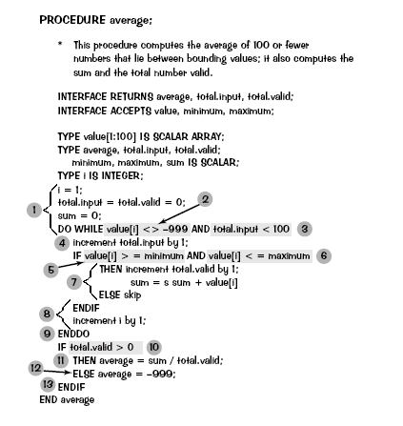
Deriving Test Cases

Slide 27
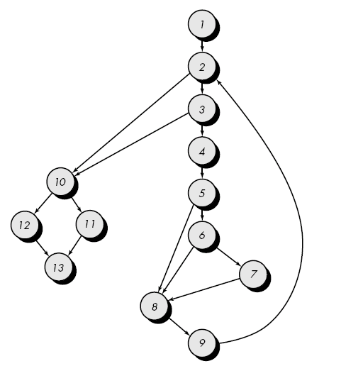
Flow graph for the procedure average

Slide 28
Determine the cyclomatic complexity of the resultant flow graph.
  V(G) can be determined without developing a flow graph by counting all conditional statements in the PDL (for the procedure average, compound conditions count as two) and adding 1
  V(G) = 6 regions
  V(G) = 17 edges - 13 nodes + 2 = 6
  V(G) = 5 predicate nodes + 1 = 6
Determine a basis set of linearly independent paths
  The value of V(G) provides the number of linearly independent paths through the program control structure.
  path 1: 1-2-10-11-13
  path 2: 1-2-10-12-13
  path 3: 1-2-3-10-11-13
  path 4: 1-2-3-4-5-8-9-2-. . .
  path 5: 1-2-3-4-5-6-8-9-2-. . .
  path 6: 1-2-3-4-5-6-7-8-9-2-. . .
  The ellipsis (. . .) following paths 4, 5, and 6 indicates that any path through the remainder of the control structure is acceptable.

Slide 29
Prepare test cases that will force execution of each path in the basis set.
  Data should be chosen so that conditions at the predicate nodes are appropriately set as each path is tested.
  Each test case is executed and compared to expected results.
  Once all test cases have been completed, the tester can be sure that all statements in the program have been executed at least once.

Slide 30
Graph Matrices
A graph matrix is a square matrix whose size (i.e., number of rows and columns) is equal to the number of nodes on the flow graph.
Each row and column corresponds to an identified node, and matrix entries correspond to connections (an edge) between nodes.
Each node on the flow graph is identify by numbers, while each edge is identify by letters.
The graph matrix is nothing more than a tabular representation of a flow graph.
By adding a link weight to each matrix entry, the graph matrix can become a powerful tool for evaluating program control structure during testing.
The link weight provides additional information about control flow. In its simplest form, the link weight is 1 (a connection exists) or 0 (a connection does not exist).

Slide 31
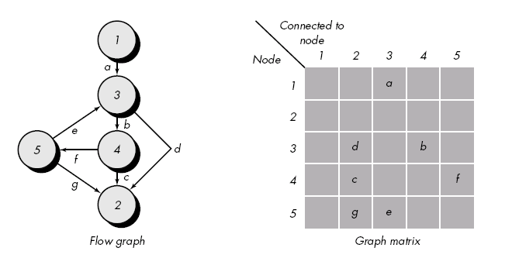

Slide 32
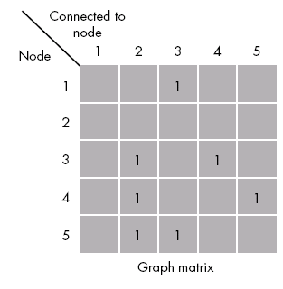
Connection matrix

Slide 33
Each letter has been replaced with a 1, indicating that a connection exists (this graph matrix is called a connection matrix).
In fig.( connection matrix) each row with two or more entries represents a predicate node.
We can directly measure cyclomatic complexity value by performing arithmetic operations
Connections = Each row Total no. of entries – 1.
V(G)= Sum of all connections + 1

Slide 34
Black box testing
Also called behavioral testing, focuses on the functional requirements of the software.
It enables the software engineer to derive sets of input conditions that will fully exercise all functional requirements for a program.
Black-box testing is not an alternative to white-box techniques but it is complementary approach.
Black-box testing attempts to find errors in the following categories:
  Incorrect or missing functions,
  Interface errors,
  Errors in data structures or external data base access.
  Behavior or performance errors,
  Initialization and termination errors.

Slide 35
Black-box testing purposely ignored control structure, attention is focused on the information domain. Tests are designed to answer the following questions:
  How is functional validity tested?
  How is system behavior and performance tested?
  What classes of input will make good test cases?
By applying black-box techniques, we derive a set of test cases that satisfy the following criteria
  Test cases that reduce the number of additional test cases that must be designed to achieve reasonable testing (i.e minimize effort and time)
  Test cases that tell us something about the presence or absence of classes of errors
Black box testing methods
  Graph-Based Testing Methods
  Equivalence partitioning
  Boundary value analysis (BVA)
  Orthogonal Array Testing

Slide 36
Graph-Based Testing Methods
To understand the objects that are modeled in software and the relationships that connect these objects.
Next step is to define a series of tests that verify “all objects have the expected relationship to one another.
Stated in other way:
  Create a graph of important objects and their relationships
  Develop a series of tests that will cover the graph
So that each object and relationship is exercised and errors are uncovered.
Begin by creating graph –
  a collection of nodes that represent objects
  links that represent the relationships between objects
  node weights that describe the properties of a node
  link weights that describe some characteristic of a link.

Slide 37
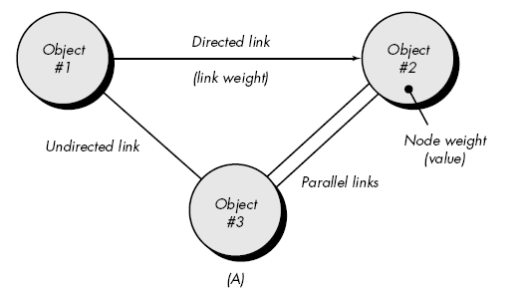

Slide 38
Nodes are represented as circles connected by links that take a number of different forms.
A directed link (represented by an arrow) indicates that a relationship moves in only one direction.
A bidirectional link, also called a symmetric link, implies that the relationship applies in both directions.
Parallel links are used when a number of different relationships are established between graph nodes.

Slide 39
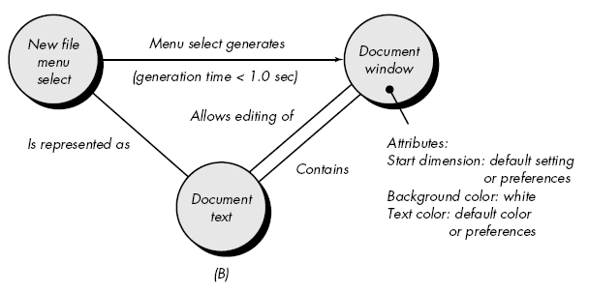
Example

Slide 40
Object #1 = new file menu select
Object #2 = document window
Object #3 = document text
Referring to example figure, a menu select on new file generates a document window.
The link weight indicates that the window must be generated in less than 1.0 second.
The node weight of document window provides a list of the window attributes that are to be expected when the window is generated.
An undirected link establishes a symmetric relationship between the new file menu select and document text,
parallel links indicate relationships between document window and document text

Slide 41
Number of behavioral testing methods that can make use of graphs:
Transaction flow modeling.
  The nodes represent steps in some transaction and the links represent the logical connection between steps
Finite state modeling.
  The nodes represent different user observable states of the software and the links represent the transitions that occur to move from state to state. (Starting point and ending point)
Data flow modeling.
  The nodes are data objects and the links are the transformations that occur to translate one data object into another.
Timing modeling.
  The nodes are program objects and the links are the sequential connections between those objects.
  Link weights are used to specify the required execution times as the program executes.

Slide 42
Equivalence Partitioning
Equivalence partitioning is a black-box testing method that divides the input domain of a program into classes of data from which test cases can be derived.
Test case design for equivalence partitioning is based on an evaluation of equivalence classes for an input condition.
An equivalence class represents a set of valid or invalid states for input conditions.
Typically, an input condition is either a specific numeric value, a range of values, a set of related values, or a Boolean condition.

Slide 43
To define equivalence classes follow the guideline
If an input condition specifies a range, one valid and two invalid equivalence classes are defined.
If an input condition requires a specific value, one valid and two invalid equivalence classes are defined.
If an input condition specifies a member of a set, one valid and one invalid equivalence class are defined.
If an input condition is Boolean, one valid and one invalid class are defined.

Slide 44
Example
area code—blank or three-digit number
prefix—three-digit number not beginning with 0 or 1
suffix—four-digit number
password—six digit alphanumeric string
commands— check, deposit, bill pay, and the like

Slide 45
area code:
  Input condition, Boolean—the area code may or may not be present.
  Input condition, value— three digit number
prefix:
  Input condition, range—values defined between 200 and 999, with specific exceptions.
Suffix:
  Input condition, value—four-digit length
password:
  Input condition, Boolean—a password may or may not be present.
  Input condition, value—six-character string.
command:
  Input condition, set— check, deposit, bill pay.

Slide 46
Boundary Value Analysis (BVA)
Boundary value analysis is a test case design technique that complements equivalence partitioning.
Rather than selecting any element of an equivalence class, BVA leads to the selection of test cases at the "edges" of the class.
In other word, Rather than focusing solely on input conditions, BVA derives test cases from the output domain as well.

Slide 47
Guidelines for BVA
If an input condition specifies a range bounded by values a and b, test cases should be designed with values a and b and just above and just below a and b.
If an input condition specifies a number of values, test cases should be developed that exercise the minimum and maximum numbers. Values just above and below minimum and maximum are also tested.
Apply guidelines 1 and 2 to output conditions.
If internal program data structures have prescribed boundaries be certain to design a test case to exercise the data structure at its boundary

Slide 48
Orthogonal Array Testing
The number of input parameters is small and the values that each of the parameters may take are clearly bounded.
When these numbers are very small (e.g., three input parameters taking on three discrete values each), it is possible to consider every input permutation .
However, as the number of input values grows and the number of discrete values for each data item increases (exhaustive testing occurs)
Orthogonal array testing can be applied to problems in which the input domain is relatively small but too large to accommodate exhaustive testing.
Orthogonal Array Testing can be used to reduce the number of combinations and provide maximum coverage with a minimum number of test cases.

Slide 49
Example
Consider the send function for a fax application.
Four parameters, P1, P2, P3, and P4, are passed to the send function. Each takes on three discrete values.
P1 takes on values:
  P1 = 1, send it now
  P1 = 2, send it one hour later
  P1 = 3, send it after midnight
P2, P3, and P4 would also take on values of 1, 2 and 3, signifying other send functions.
OAT is an array of values in which each column represents a Parameter - value that can take a certain set of values called levels.
Each row represents a test case.
Parameters are combined pair-wise rather than representing all possible combinations of parameters and levels

Slide 50
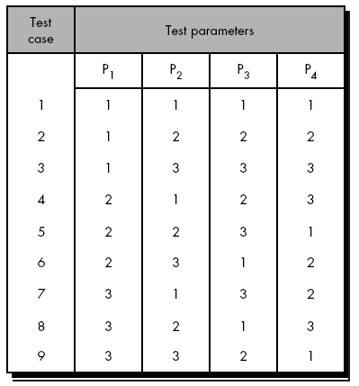

Slide 51
Software Maintenance
Software Maintenance is the process of modifying a software product after it has been delivered to the customer.
The main purpose of software maintenance is to modify and update software applications after delivery to correct faults and to improve performance.
Software maintenance is done after the product has launched for several reasons including improving the software overall, correcting issues or bugs, to boost performance, and more.

Slide 52
Reasons for Software Maintenance
There are number of reasons, why modifications are required, some of them are briefly mentioned below:
Market Conditions - Policies, which changes over the time, such as taxation and newly introduced constraints like, how to maintain bookkeeping, may trigger need for modification.
Client Requirements - Over the time, customer may ask for new features or functions in the software.
Host Modifications - If any of the hardware and/or platform (such as operating system) of the target host changes, software changes are needed to keep adaptability.
Organization Changes - If there is any business level change at client end, such as reduction of organization strength, acquiring another company, organization venturing into new business, need to modify in the original software may arise.

Slide 53
Need for Software Maintenance
Software Maintenance must be performed in order to:
Correct faults.
Improve the design.
Implement enhancements.
Interface with other systems.
Accommodate programs so that different hardware, software, system features, and telecommunications facilities can be used.
Migrate legacy software.
Retire software.

Slide 54
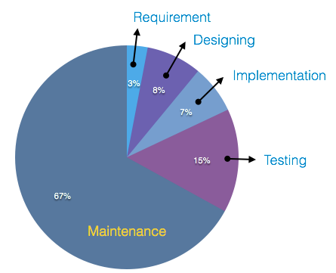
Cost of Software Maintenance
Reports suggest that the cost of maintenance is high. A study on estimating software maintenance found that the cost of maintenance is as high as 67% of the cost of entire software process cycle.

Slide 55
Types of Software Maintenance
Maintenance can be divided into the following:
Corrective maintenance:
Corrective maintenance of a software product may be essential either to rectify some bugs observed while the system is in use, or to enhance the performance of the system.
Adaptive maintenance:
This includes modifications and updations when the customers need the product to run on new platforms, on new operating systems, or when they need the product to interface with new hardware and software.

Slide 56
Types of Software Maintenance
Perfective maintenance:
A software product needs maintenance to support the new features that the users want or to change different types of functionalities of the system according to the customer demands.
Preventive maintenance:
This type of maintenance includes modifications and updations to prevent future problems of the software. It goals to attend problems, which are not significant at this moment but may cause serious issues in future.

Slide 57
Software Re-engineering
When we need to update the software to keep it to the current market, without impacting its functionality, it is called software re-engineering. It is a thorough process where the design of software is changed and programs are re-written.
Legacy software cannot keep tuning with the latest technology available in the market. As the hardware become obsolete, updating of software becomes a headache. Even if software grows old with time, its functionality does not.
For example, initially Unix was developed in assembly language. When language C came into existence, Unix was re-engineered in C, because working in assembly language was difficult.
Other than this, sometimes programmers notice that few parts of software need more maintenance than others and they also need re-engineering.

Slide 58
Software Re-engineering Process
Decide what to re-engineer. Is it whole software or a part of it?
Perform Reverse Engineering, in order to obtain specifications of existing software.
Restructure Program if required. For example, changing function-oriented programs into object-oriented programs.
Re-structure data as required.
Apply Forward engineering concepts in order to get re-engineered software.

Slide 59
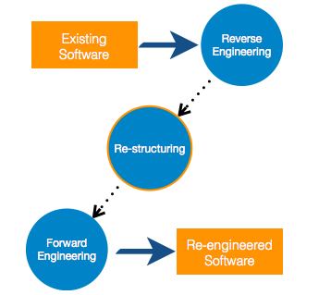
Software Re-engineering

Slide 60
Software Re-engineering
There are few important terms used in Software re-engineering
Reverse Engineering
It is a process to achieve system specification by thoroughly analyzing, understanding the existing system. This process can be seen as reverse SDLC model, i.e. we try to get higher abstraction level by analyzing lower abstraction levels.
Software Reverse Engineering is the process of recovering the design and the requirements specification of a product from an analysis of it’s code.

Slide 61

Software Re-engineering
An existing system is previously implemented design, about which we know nothing. Designers then do reverse engineering by looking at the code and try to get the design. With design in hand, they try to conclude the specifications. Thus, going in reverse from code to system specification.

Slide 62
Software Re-engineering
Why Reverse Engineering?
Providing proper system documentation.
Recovery of lost information.
Assisting with maintenance.
Facility of software reuse.
Discovering unexpected flaws or faults.

Slide 63
Software Re-engineering
Program Restructuring
It is a process to re-structure and re-construct the existing software. It is all about re-arranging the source code, either in same programming language or from one programming language to a different one. Restructuring can have either source code-restructuring and data-restructuring or both.
Re-structuring does not impact the functionality of the software but enhance reliability and maintainability. Program components, which cause errors very frequently can be changed, or updated with re-structuring.
The dependability of software on obsolete hardware platform can be removed via re-structuring.

Slide 64
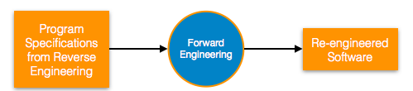
Software Re-engineering
Forward Engineering
Forward engineering is a process of obtaining desired software from the specifications in hand which were brought down by means of reverse engineering. It assumes that there was some software engineering already done in the past.
Forward engineering is same as software engineering process with only one difference – it is carried out always after reverse engineering.

